Slide 1

User Manual

Slide 2
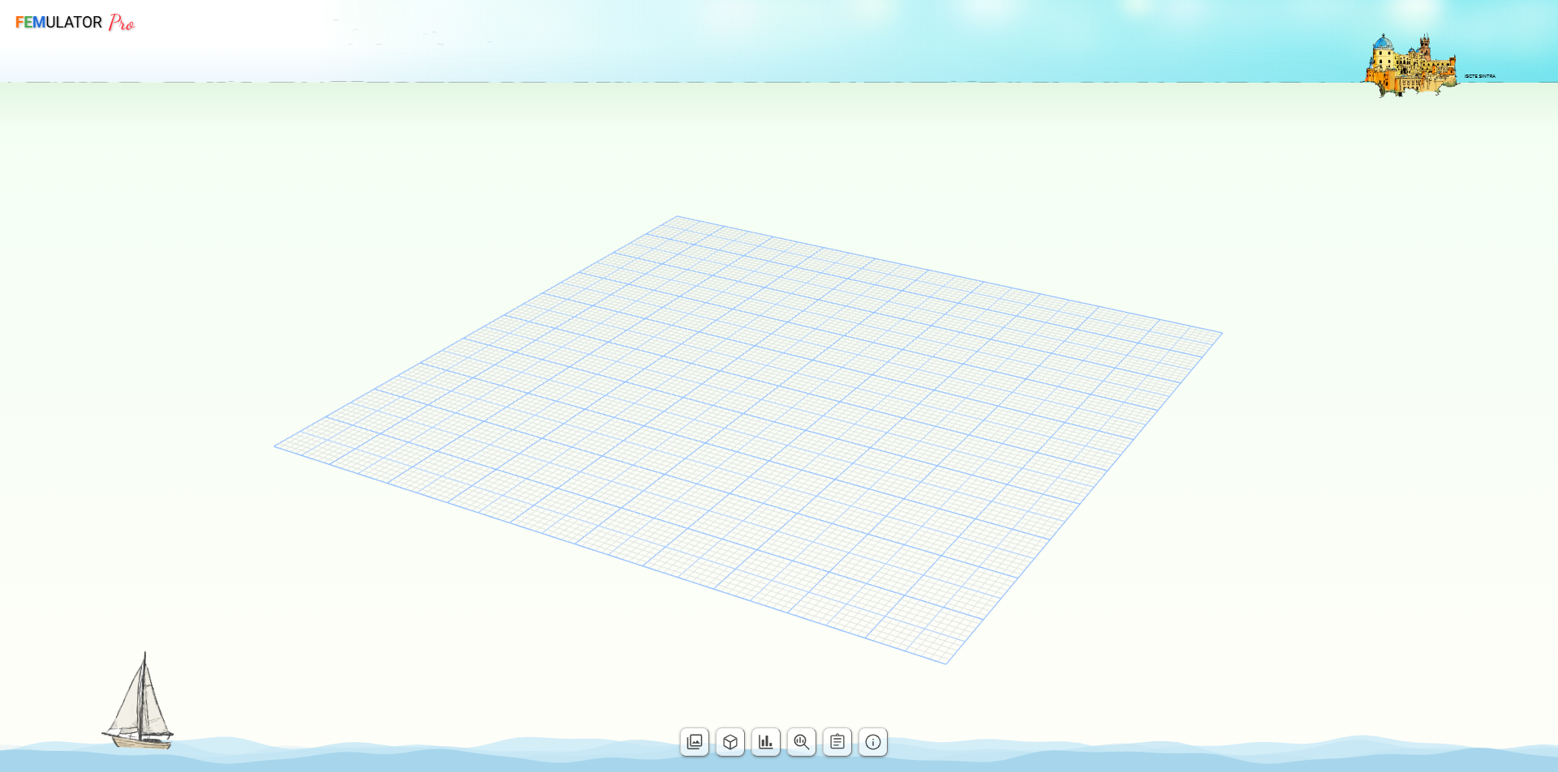
User Interface

Slide 3
Control Buttons
1
Simulations Gallery
2
Simulation Details, Metrics & Settings
3
Benchmark & Simulations History
4
Profiling
1
2
3
4
5
6
5
Reporting
6
About

Slide 4
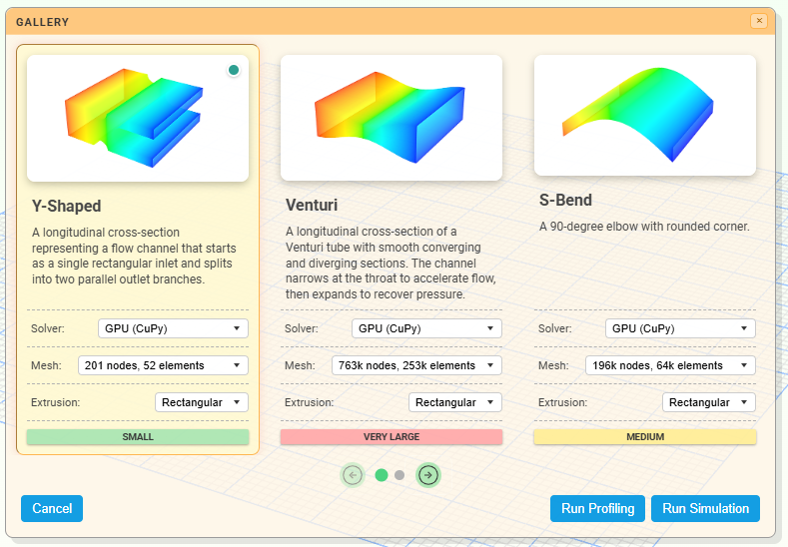
1 – Simulations Gallery

Slide 5
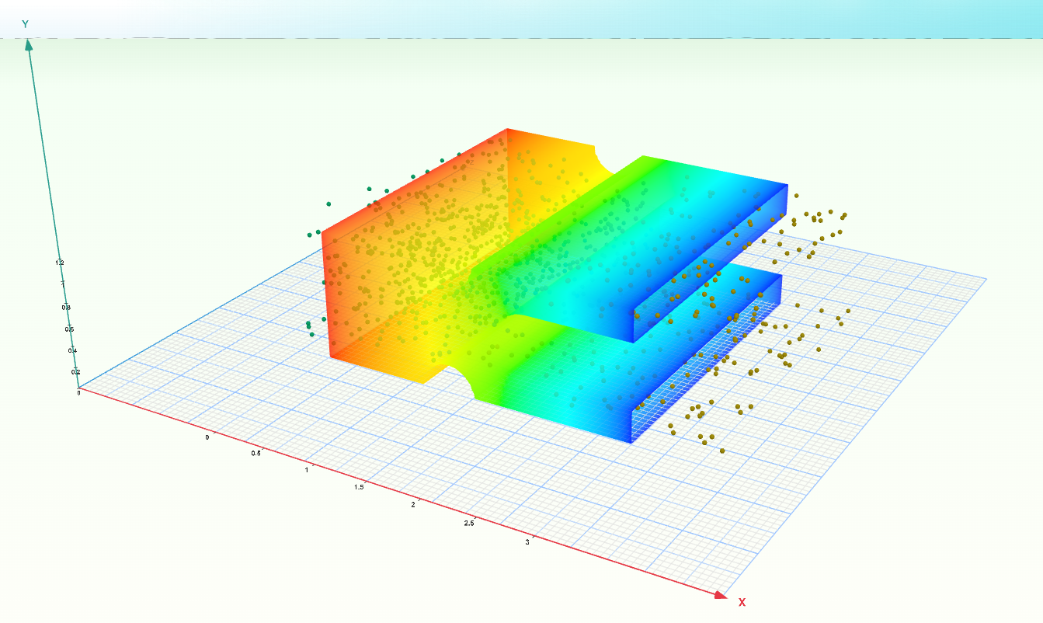
1 – Simulation

Slide 6
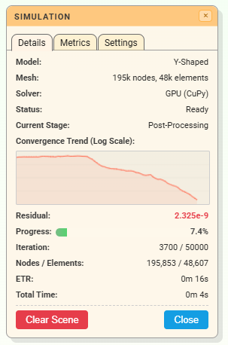
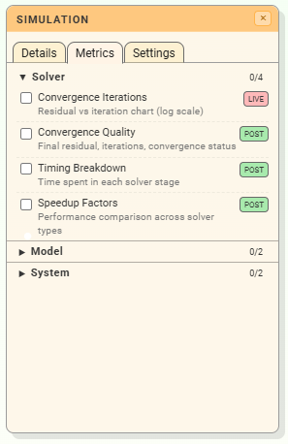
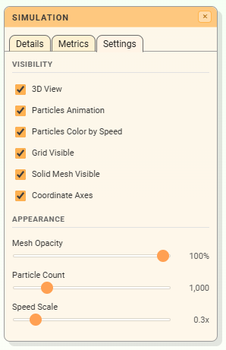
2 – Simulation Details, Metrics & Settings

Slide 7
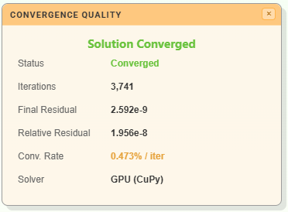
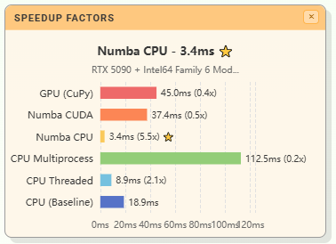
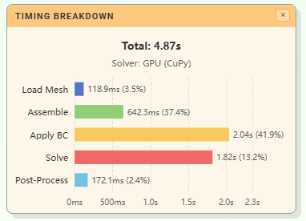
2 – Simulation Metrics - Examples

Slide 8
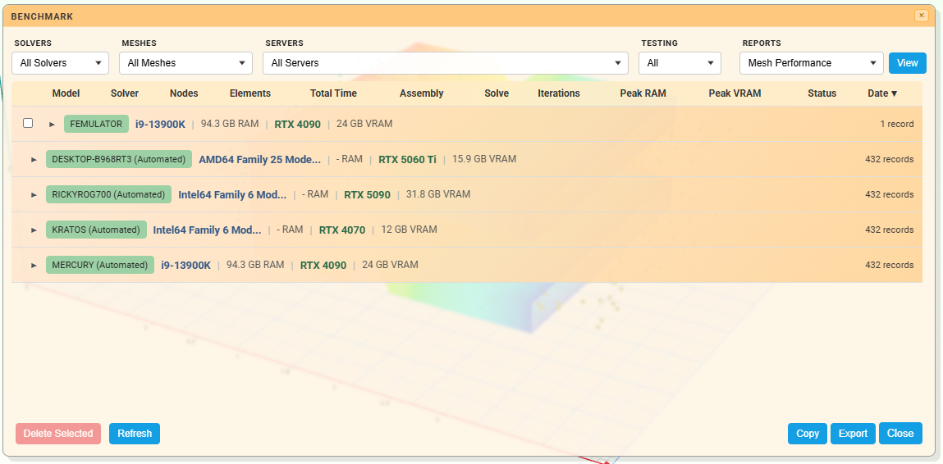
3 – Benchmark & Simulations History

Slide 9
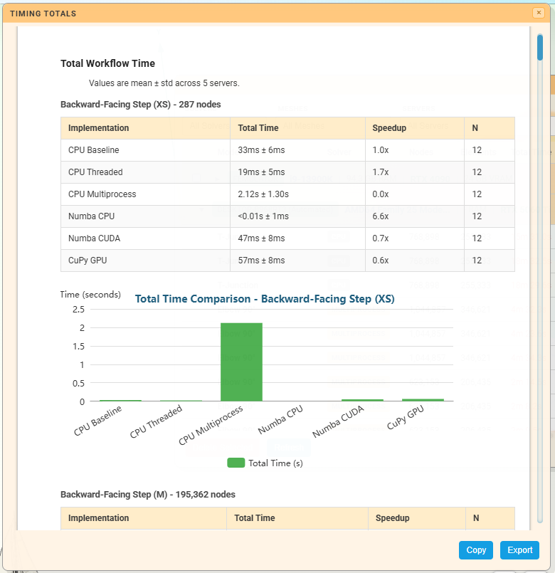
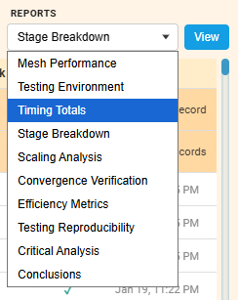
3 – Benchmark & Simulations History - Reports

Slide 10
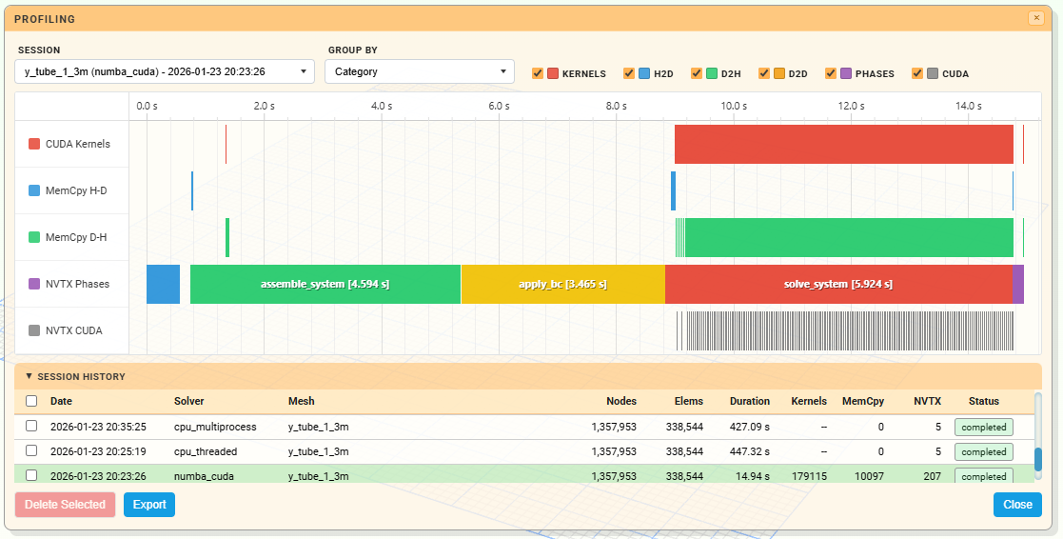
4 – Profiling

Slide 11
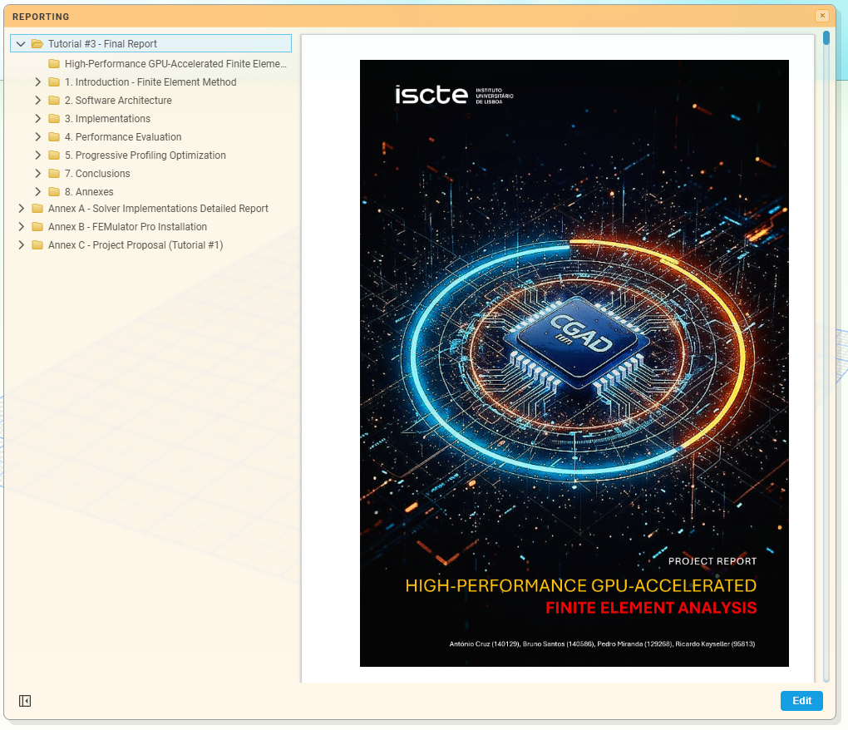
5 – Reporting

Slide 12
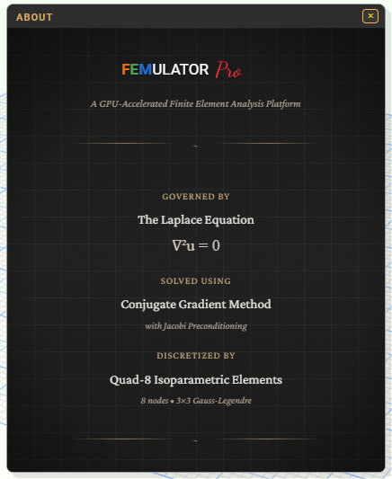
6 - About

